Slide 1


Project 1 Quantum Walks and Monte Carlo
Muhammad Nauman gst-4u0NZJaROvxcug3

Slide 2

Problem Statement
Generalise quantum Galton board for n-layers.
Verify output of a gaussian using chi-squared test.
Modify the circuit to implement different target distributions.

Slide 3
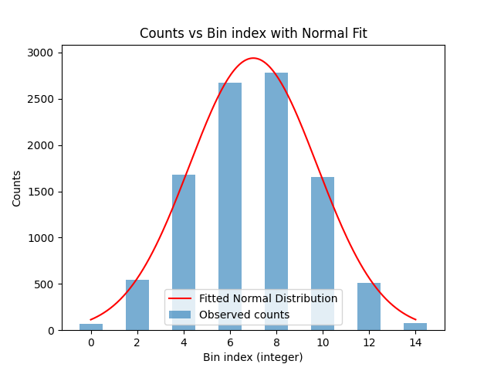
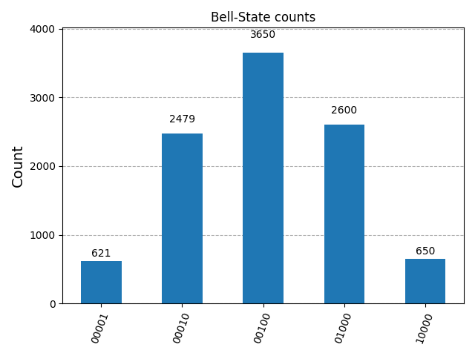
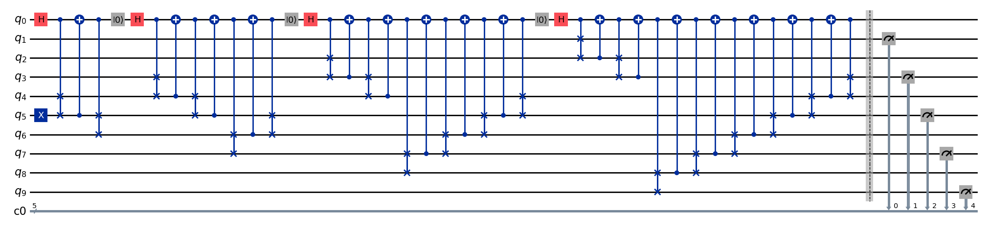
Solution – Gaussian circuit
Circuit and histogram for Gaussian Galton box with 4 layers.
Chi squared test was done on the normal fit, even though the test statistic was low it is clear to see the general gaussian trend.

Slide 4
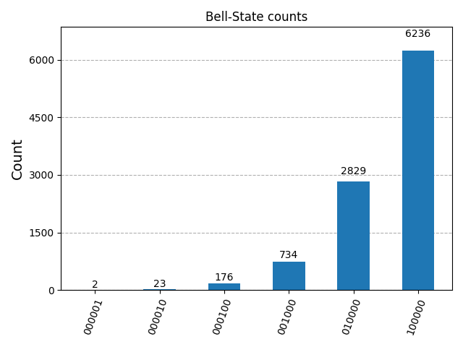
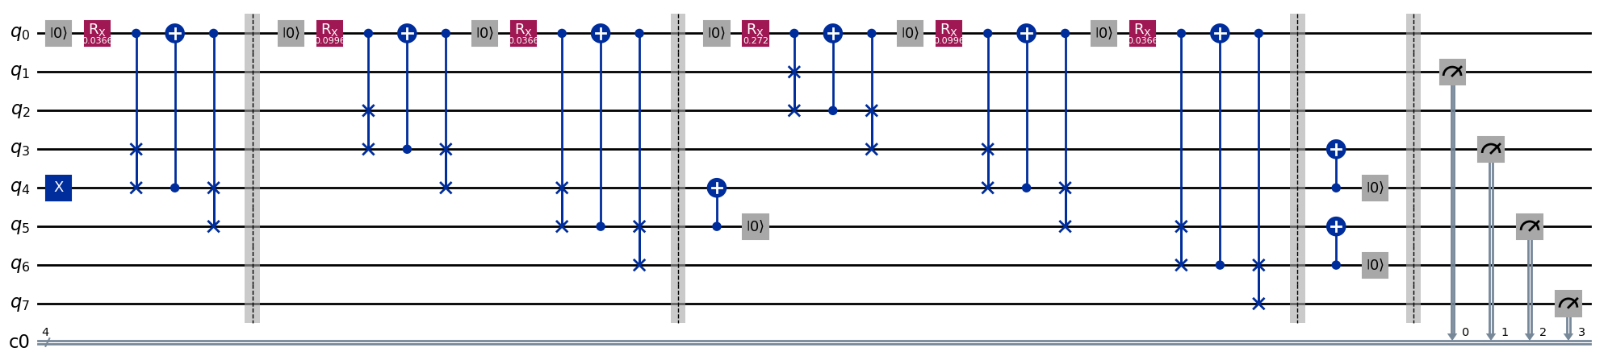
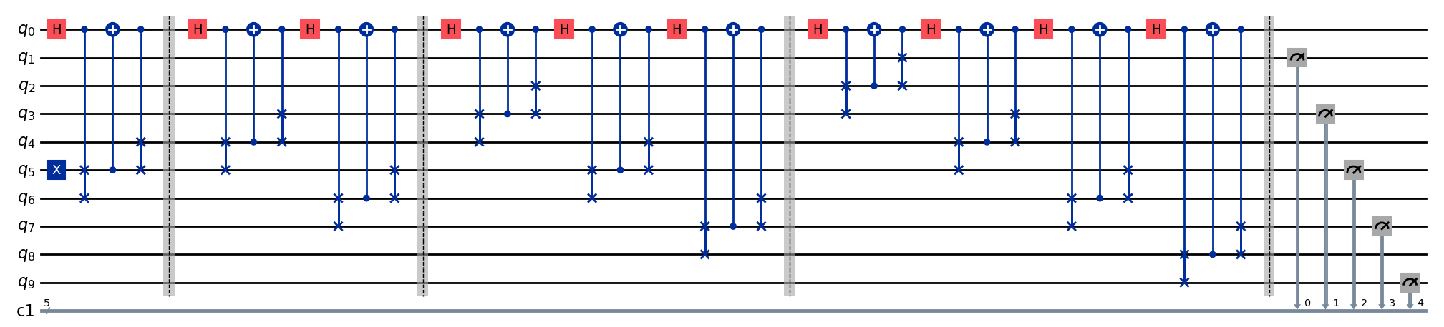
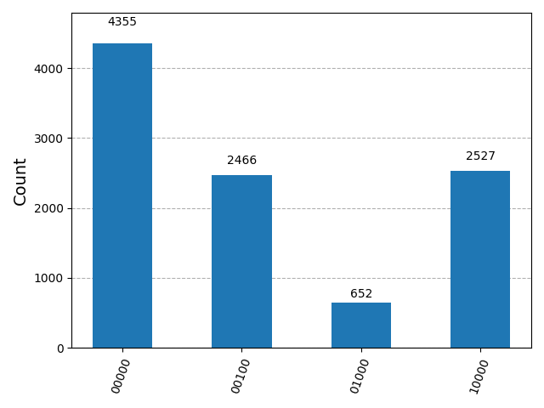
Solution – Exponential and Hadamard
Circuit and histogram for exponential Galton box with 4 layers.​
Circuit and histogram for Hadamard quantum walk with 4 layers.​

Slide 5
Future Scope
Add noise models to get a more realistic model of the real-world applications.
Hadamard quantum walk slight asymmetrical feature most likely due to ciruit implementation.

